Slide 1
COVID19
Most Up-to-Date Information on COVID and Fertility
Abigail A. Delaney, MD

Slide 2
Disclosures….
None

Slide 3
Start from the Beginning
mRNA
Pfizer-BioNTech
Moderna
Adenovirus Vector
Janssen/JnJ
AstraZeneca
Protein Subunit
Novavax
Pfizer-BioNTech
-Two doses, 3 weeks apart
-mRNA with lipid nanopeptide
-EUA issued 12/2020
-FDA approved 8/2021
Moderna
-Two doses, 4 weeks apart
-mRNA with lipid nanopeptide
-EUA issued 12/2020
JnJ
-One dose
-Human adenovirus vector
-EUA 2/2021
AstraZeneca
-Two doses, 4 weeks apart
-Chimp adenovirus vector
-US Phase III trial ongoing
-Approved in UK/WHO
Novavax
-Two doses, 3 weeks apart
-Nonparticle vaccine with Matrix-M1 adjuvant
-Phase III Trials Ongoing

Slide 4
Efficacy data: Pfizer-BioTech Data Phase III Data
Primary Endpoint: Symptomatic, laboratory-confirmed COVID 19 among subjects without evidence of prior infection
Efficacy: 95% (90.3-97.6%)
HIGH efficacy (>92%) adults >65 years of age: 94.7% (66.7-99.9%)
Efficacy against severe disease:
FDA definition: 66.4%
CDC definition: 100%
**FDA definition: RR>30, SpO2<93 on RA, Respiratory failure, ARDS or evidence of hemodynamic shock OR evidence of renal failure, hepatic or neurologic dysfunction, or admission to an ICU
**CDD definition: Hospitalization, admission to ICU, intubation or mechanical ventilation or death

Slide 5
Pfizer-BioTech Safety Data
Local reactions occurring within 7 days were common
Systemic reactions within 7 days were common: fatigue headache and muscle pain
Symptom onset usually 1-2 days post vaccination
Most symptoms resolved within 1 day

Slide 6
Efficacy data: Moderna COVID-19 Vaccine Phase III Data
Primary efficacy endpoint: Symptomatic laboratory confirmed COVID-10 among subjects without evidence of prior infection
Efficacy: 94.1% (89.3%-96.8%)
High efficacy
Adults age 18-64: 95%
Adults age >65: 86%
Adults age >75: 100%

Slide 7
What About J&J?
Efficacy against symptomatic, laboratory-confirmed COVID-19
Efficacy 66.3%
Efficacy against associated hospitalization: 93%

Slide 8
Summary of the Available Evidence
No trials compared efficacy of the vaccines in the same study at the same time
All authorized COVID -19 vaccines demonstrated efficacy against COVID-19
All authorized COVID-19 vaccines demonstrated HIGH (>89%) efficacy against symptomatic lab-confirmed COVID requiring hospitalization
In the vaccine trials NO patient who had a breakthrough infection died
Moderna and J&J trials each had COVID-19 deaths in the placebo arm

Slide 9
How do they Work??

Slide 10
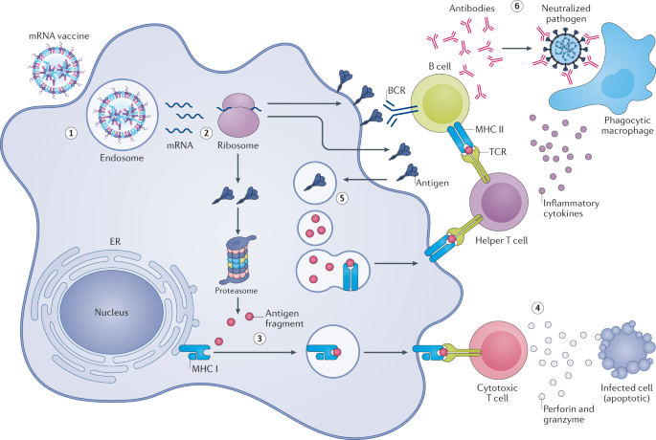

Slide 11
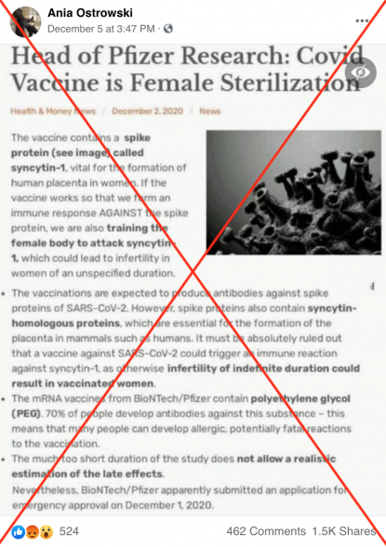
DOES COVID VACCINE CAUSE FEMALE STERILIZATION????
Answer: No

Slide 12
Biological Plausibility
Where did this come from?
Proteins are sequences of amino acids
When you compare Syncitin 1 to the Spike protein, there is a FOUR amino acid overlap
What is Syncitin 1?
Important in forming the human placenta
Theory
Making antibodies to the COVID spike protein will make antibodies to Syncitin 1 and therefore the human placenta

Slide 13
HOST ANTIGEN RESPONSE
REQUIRES 50-80 MATCHED AMINO ACIDS
HOW CLOSELY LINKED ARE THE TWO PROTEINS? FOUR AMINO ACIDS

Slide 14
Does COVID cause infertility?

Slide 15
Morris 2021
Every patient had antibodies drawn prior to proceeding with an embryo transfer
If positive antibody, asked if they had the vaccine or infection
Outcomes of the two groups were then compared to patients who had negative antibodies (COVID-19 naïve)
Pfizer and Moderna vaccines used

Slide 16
Morris 2021 Continued…
143 embryo transfers performed
Controlled cycles
All single embryo transfers
37.8% of patients had a + antibody level
64% from vaccine, remaining infection or presumed infection
No difference in pregnancy rates

Slide 19
Orvieto et al.
Couples undergoing more than one IVF cycle
1.) Underwent IVF 2.) Had a vaccination 3.) Underwent IVF again
THEIR OWN CONTROL!!

Slide 20
Orvieto et al. continued….
IVF Cycle is truly an overall evaluation of female fertility
Infertile women generally require more medication, more days of stimulation, make less eggs, make less embryos……
NO DIFFERENCE BEFORE OR AFTER VACCINATION

Slide 21
OVARIAN FUNCTION NOT CHANGED AFTER VACCINATION

Slide 22
EXPERT OPINION: AMERICAN SOCIETY for REPRODUCTIVE MEDICINE July 2021
Vaccination either pre-conception or early during pregnancy is the best way to reduce maternal/fetal complications.
None of the currently available COVID-19 vaccines reach or cross the placenta. The intramuscularly administered vaccine mRNA remains in the deltoid muscle cell cytoplasm for three days prior to destruction.
COVID19 vaccination does not induce antibodies against the placenta
Existing data suggest COVID19 vaccination during pregnancy does not increase risk of miscarriage.
COVID19 vaccination does not impact male or female fertility or fertility treatment outcomes.

