Slide 1
COVID-19 Vaccine in Pregnancy and Lactation
Emily Patel, MD, FACOG
Maternal Fetal Medicine
Methodist Perinatal

Slide 2
Pfizer
Aug 2021: FDA approval Comirnaty
RCT >43,000 participants (12 and older)
(12-15yo approved May 2021)
People with stable chronic conditions WERE included (HIV, hepatitis, diabetes, cHTN)
Polack et.al. Safety and Efficacy of the BNT162b2 mRNA Covid-19 Vaccine. NEJM: Dec 11, 2020

Slide 3
Moderna
Dec 2020: FDA EUA
RCT in >30,000 participants
18yo and older
People with stable chronic conditions WERE included (HIV, hepatitis, diabetes, cHTN)
Baden et.al. Efficacy and Safety of the mRNA-1273 SARS-CoV-2 Vaccine

Slide 4
Johnson and Johnson
Feb 2020: FDA EUA
One dose vaccine
Viral vector
Rare adverse event called thrombosis with thrombocytopenia syndrome (TTS).
2 per million doses
J&J/Janssen COVID-19 vaccine’s known and potential benefits outweigh its known and potential risks.
Notes:
Most reports of this serious condition, which involves blood clots with low platelets, have been in adult women younger than 50 years old.
However, women younger than 50 years old especially should be aware of the rare but increased risk of this adverse event, and they should know about other available COVID-19 vaccine options for which this risk has not been seen.
The updated incidence as of the CDC review was two per million for the JJ vaccine, based on a total of 15 cases reported following 7.98 million doses administered. The most recent information from the United Kingdom suggests an incidence for the AstraZeneca vaccine of 20.3 per million doses in those aged 18 to 49 years compared to 10.9 per million doses in those aged 50 years and older.
Death from COVID 2-4/1000

Slide 5
Administration
Pfizer and Moderna: 2-dose series, IM, 3-4 weeks apart
J&J: 1-dose
Can be given to those with hx of SARS-CoV-2 illness
May be given at the same time as other vaccines
Polack et.al. Safety and Efficacy of the BNT162b2 mRNA Covid-19 Vaccine. NEJM: Dec 11, 2020
Baden et.al. Efficacy and Safety of the mRNA-1273 SARS-CoV-2 Vaccine
Oliver et.al. The Advisory Committee on Immunization Practices’ Interim Recommendation for Use of Pfizer-BioNTech COVID-19 Vaccine. MMWR: Dec 13, 2020
Oliver et.al. The Advisory Committee on Immunization Practices’ Interim Recommendation for Use of Moderna COVID-19 Vaccine — United States, December 2020

Slide 6
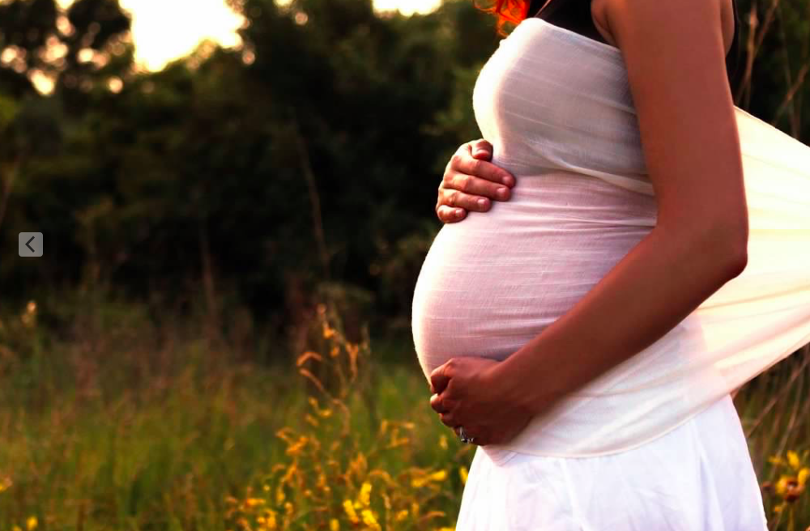
Pregnancy and COVID-19 Illness

Slide 7
Pregnancy and COVID Illness
COVID-19 illness and pregnancy
ICU admission (5-fold increase)
Preeclampsia/HELLP (75% increase)
Death (22-fold increase)
Fetal Distress (70% increase)
Preterm birth (60% increase)
Severe neonatal morbidity (2.6-fold increase)
Villar, et.al. Maternal and Neonatal Morbidity and Mortality Among Pregnant Women With and Without COVID-19 Infection. The INTERCOVID Multinational Cohort Study. JAMA Ped. 2021;175(8):817-826
Badr et.al. Are clinical outcomes worse for pregnant women at ≥20 weeks' gestation infected with coronavirus disease 2019? A multicenter case-control study with propensity score matching. Am J Obstet Gynecol. 2020;223(5):764.
Zambrano et.al. Update: Characteristics of Symptomatic Women of Reproductive Age with Laboratory-Confirmed SARS-CoV-2 Infection by Pregnancy Status - United States, January 22-October 3, 2020. MMWR Morb Mortal Wkly Rep. 2020;69(44):1641. Epub 2020 Nov 6.
Notes:
Compared symptomatic non pregnant women with sx pregnant women
SNM: HIE, sepsis, BPD, anemia requiring transfusion, pDA, IVH, nec, retinopathy
These findings held true even for those women without comorbidities
Death: 11/706 with covid, 1/1424 without covid

Slide 8
Pregnancy and COVID Illness
Other critical risks:
Pneumonia, ARDS
Arrhythmias
VTE
Secondary infections
Acute kidney failure
Neurologic disorders – Headache, strokes, seizures
Gastrointestinal and liver disorders
Villar, et.al. Maternal and Neonatal Morbidity and Mortality Among Pregnant Women With and Without COVID-19 InfectionThe INTERCOVID Multinational Cohort Study. JAMA Ped. 2021;175(8):817-826
Badr et.al. Are clinical outcomes worse for pregnant women at ≥20 weeks' gestation infected with coronavirus disease 2019? A multicenter case-control study with propensity score matching. Am J Obstet Gynecol. 2020;223(5):764.
Zambrano et.al. Update: Characteristics of Symptomatic Women of Reproductive Age with Laboratory-Confirmed SARS-CoV-2 Infection by Pregnancy Status - United States, January 22-October 3, 2020. MMWR Morb Mortal Wkly Rep. 2020;69(44):1641. Epub 2020 Nov 6.

Slide 9
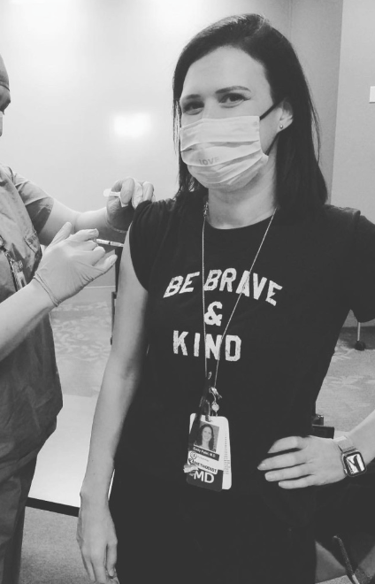
COVID-19 Vaccine Efficacy

Slide 10
Efficacy of vaccination
mRNA vaccines (Pfizer and Moderna)
95% and 94% effective (respectively) in prevention of COVID-19/severe COVID-19 illness
“Real-world” data outside the RCT has demonstrated 90% efficacy
Viral vector vaccine (J&J)
72% effective at prevention of moderate COVID
85% effective at prevention of severe COVID
100% effective at prevention of hospitalization 28d after vaccination

Slide 11
Efficacy in pregnancy
mRNA vaccines produce same level of antibody response
Clinical efficacy similar to non-pregnant
Goldshtein. Association Between BNT162b2 Vaccination and Incidence of SARS-CoV-2 Infection in Pregnant Women. JAMA 2021;326(8):728-735

Slide 12
Vaccine booster
Booster vs additional dose
Booster for those who are NOT immunocompromised
Additional dose for those that are immunocompromised
Approved to start in Sept
8 mon after second dose
mRNA vaccines only at this time
Notes:
The COVID-19 vaccines authorized in the United States continue to be highly effective in reducing risk of severe disease, hospitalization, and death, even against the widely circulating Delta variant. However, COVID-19 constantly evolves. Experts are looking at all available data to understand how well the vaccines are working, including how new variants, like Delta, affect vaccine effectiveness. If FDA authorizes and ACIP recommends it, the goal is for people to start receiving a COVID-19 booster shot this fall.
If we need a booster dose, does that mean that the vaccines aren’t working?
No. COVID-19 vaccines are working very well to prevent severe illness, hospitalization, and death, even against the widely circulating Delta variant. However, with the Delta variant, public health experts are starting to see reduced protection against mild and moderate disease. For that reason, the U.S. Department of Health and Human Services (HHS) is planning for a booster shot so vaccinated people maintain protection over the coming months.
What’s the difference between a booster dose and an additional dose?
Sometimes people who are moderately to severely immunocompromised do not build enough (or any) protection when they first get a vaccination. When this happens, getting another dose of the vaccine can sometimes help them build more protection against the disease. This appears to be the case for some immunocompromised people and COVID-19 vaccines. CDC recommends moderately to severely immunocompromised people consider receiving an additional (third) dose of an mRNA COVID-19 vaccine (Pfizer-BioNTech or Moderna) at least 28 days after the completion of the initial 2-dose mRNA COVID-19 vaccine series.
In contrast, a “booster dose” refers to another dose of a vaccine that is given to someone who built enough protection after vaccination, but then that protection decreased over time (this is called waning immunity). HHS has developed a plan to begin offering COVID-19 booster shots to people this fall. Implementation of the plan is subject to FDA’s authorization and ACIP’s recommendation.

Slide 13
Maternal Vaccine Safety in Pregnancy

Slide 14
Vaccination in pregnancy
NEJM V-safe data (mRNA vaccines)
Published June 2021
>35,000 pregnant women identified as pregnant
Enrolled 3,958 of those women in the study
The following outcomes were tracked
Miscarriage
Stillbirth
Small for gestational age
Preterm birth
Congenital Anomalies
Neonatal Death
Shimabukuro. Preliminary Findings of mRNA Covid-19 Vaccine Safety in Pregnant Persons. NEJM. June 2021: 384; 24

Slide 15
Vaccination in pregnancy

Slide 16
Fetal Vaccine Safety in Pregnancy

Slide 17
Vaccination and the fetus
Developmental and Reproductive Toxicology (DART)
CDC v-safe program (>150,000 women)
Inadvertent pregnancies during RCT
Ongoing studies

Slide 18
Vaccination and the fetus
Antibody protection
Cross the placenta to the fetus and may provide protection for the newborn
Longer the interval from vaccination, higher the antibody titer
Influenza
MATERNAL vaccination is 91.5% effective in prevention of hospitalization up to 6m after birth
Tdap
MATERNAL vaccination 85% effective at prevention of pertussis in infants <2m
Benowitz et.atl. Influenza vaccine given to pregnant women reduces hospitalization due to influenza in their infants. Clin Infect Dis. 2010 Dec 15;51(12):1355-61
Beharier et.al. Efficient maternal to neonatal transfer of antibodies against SARS-CoV-2 and BNT162b2 mRNA COVID-19 vaccine. Journal of Clinical Investigation: 2021;131(13):e150319
Gray KJ, Bordt EA, Atyeo C, et al. Coronavirus disease 2019 vaccine response in pregnant and lactating women: a cohort study. Am J Obstet Gynecol 2021
Notes:
Influenza vaccine given to pregnant women is 91.5% effective in preventing hospitalization of their infants for influenza in the first 6 months of life.
The study found that getting Tdap during gestational weeks 27 through 36 weeks is 85% more effective at preventing pertussis in infants younger than 2 months old.

Slide 19
COVID Vaccination and Lactation

Slide 20
COVID Vaccine Lactation
Not live virus vaccine, not a risk for the newborn
Consider we allow breastfeeding in COVID+ mother
No need to avoid or discontinue breastfeeding or pumping during receipt of vaccine
Antibody protection
Riley et.al. Vaccinating Pregnant and Lactating Patients Against COVID-19. ACOG Practice Advisory. Dec 2020.
Beharier et.al. Efficient maternal to neonatal transfer of antibodies against SARS-CoV-2 and BNT162b2 mRNA COVID-19 vaccine. Journal of Clinical Investigation: 2021;131(13):e150319
Gray KJ, Bordt EA, Atyeo C, et al. Coronavirus disease 2019 vaccine response in pregnant and lactating women: a cohort study. Am J Obstet Gynecol 2021

Slide 21
Vaccine Myths
Myths:
The vaccine will alter fetal/newborn DNA
mRNA does not enter nucleus and is degraded after production of the spike protein antigen
The vaccine causes infertility
Syncytin-1 shares 1 peptide (3 amino acids) in common with the spike protein.
Syncytin-1 has a total of 538 aa and Spike protein has 510 aa
“Mistaking a dog for a cat because they are wearing the same collar”
Immune system does not recognize such small peptides as antigens to attack (<1% similar)
Notes:
Even if it did cross, would be destroyed by fetal gut acid

Slide 22
Ongoing monitoring
V-SAFE
CDC surveillance, smart phone based
Pregnancy and lactation info to be collected
Vaccine Adverse Event Reporting System (VAERS)
Early warning system for safety concerns
HCP to report significant adverse events

Slide 23
Vaccine confidence
No steps were skipped in development and evaluation of the mRNA COVID-19 vaccine
mRNA has been studied for over a decade for use as a vaccine and was a candidate vaccine for SARS-CoV-1 and MERS
Can be produced in large quantity in vitro

Slide 24
Bottom line
It is RECOMMENDED that women who are considering pregnancy, pregnant or lactating should get the COVID-19 vaccine.
Resources: (SMFM, ACOG, ASRM, CDC, ACIP)

Slide 25
QUESTIONS?

